Slide 1
MaxLang Compiler - Project Report
Maximum Finder Language
Presented by: Muhammad Muneeb (2312160) & Abdul Wasay Tabba (2312144)
Course: Compiler Construction
Instructor: Syed Sajjad Raza Abidi
Date: December 14, 2024

Slide 2
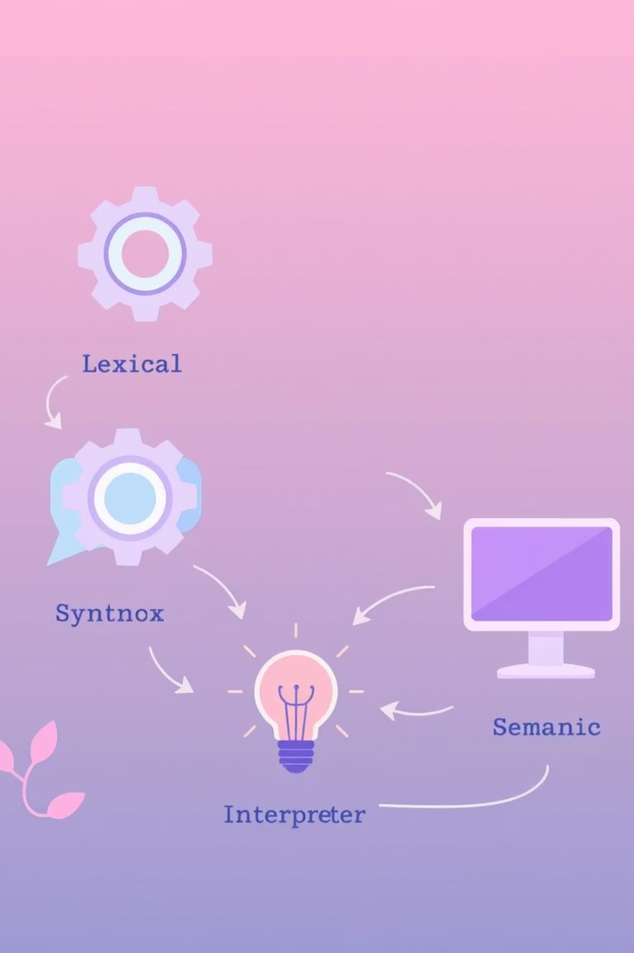
Executive Summary: The MaxLang Vision
The MaxLang Compiler project delivers a robust, domain-specific language (DSL) designed for efficiently identifying maximum values among integers. This compiler fully implements the four critical phases of compilation:
Lexical Analysis: Breaking down source code into tokens.
Syntax Analysis: Constructing a structured representation (AST).
Semantic Analysis: Ensuring logical and type correctness.
Interpretation: Executing the program directly from the AST.

Slide 3


Project Objectives: Foundations of Learning & Success
Learning Goals
Success Criteria
Our primary objective was to gain a profound understanding of compiler design principles, focusing on the intricate interactions between each phase. We also aimed to master robust error handling and recovery mechanisms, crucial for practical compiler development.
100% Test Pass Rate: Ensuring flawless execution across all defined test cases.
Robust Error Recovery: The compiler must gracefully handle errors without premature termination.
Comprehensive Documentation: Providing clear and thorough explanations of the compiler's architecture and functionality.

Slide 4
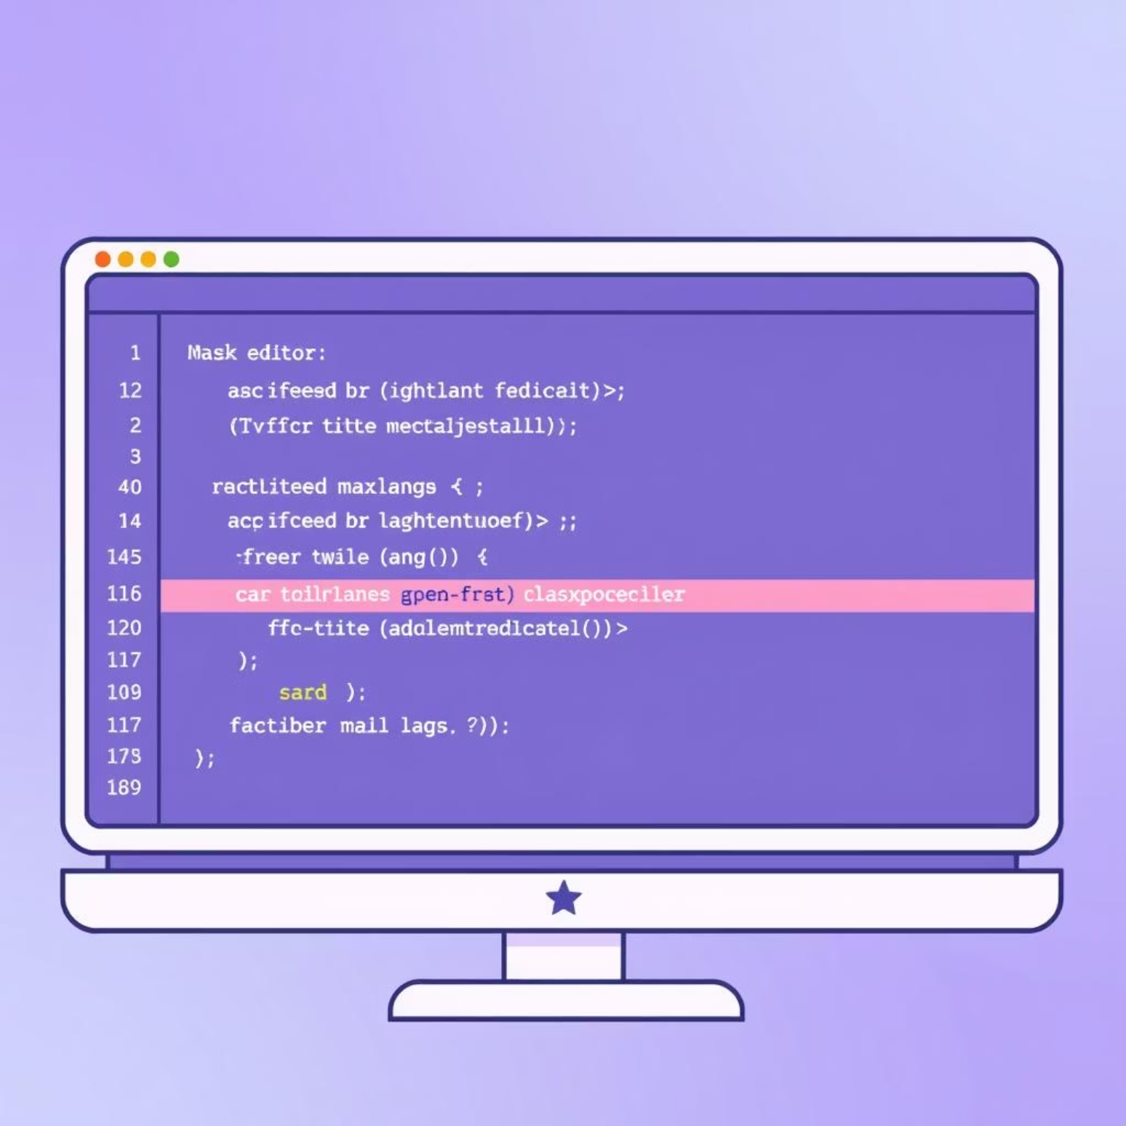
MaxLang Design: Core Features & Grammar
Language Features
Example 1: Basic Maximum
Integer Variables: Support for standard integer data types.
int a = 10; int b = 20; int c = max(a, b); print c; // Expected: 20
max(a,b) Function: The central function for finding the maximum of two integer expressions.
Arithmetic Operations: Basic operations (addition, subtraction, multiplication, division).
Print Statements: For displaying output to the console.
Grammar
The MaxLang grammar is meticulously designed to be LL(1) parseable, ensuring efficient and deterministic top-down parsing without backtracking.

Slide 5

Phase 1: Lexical Analysis - Tokenizing the Source
Strategy: Hand-Coded Lexer
Features: Rich Token Set
We implemented a custom, hand-coded lexer for precise control and optimization over token recognition. This approach allowed for fine-grained handling of language specifics.
Over 15 distinct token types recognized, including keywords, identifiers, operators, and literals.
Position Tracking: Every token maintains its line and column information for accurate error reporting.
Whitespace & Comments: Efficiently skips whitespace and single-line/multi-line comments.
Complexity: Linear Time
The lexical analysis phase operates with a time complexity of O(n), ensuring performance scales linearly with the input program size.

Slide 6
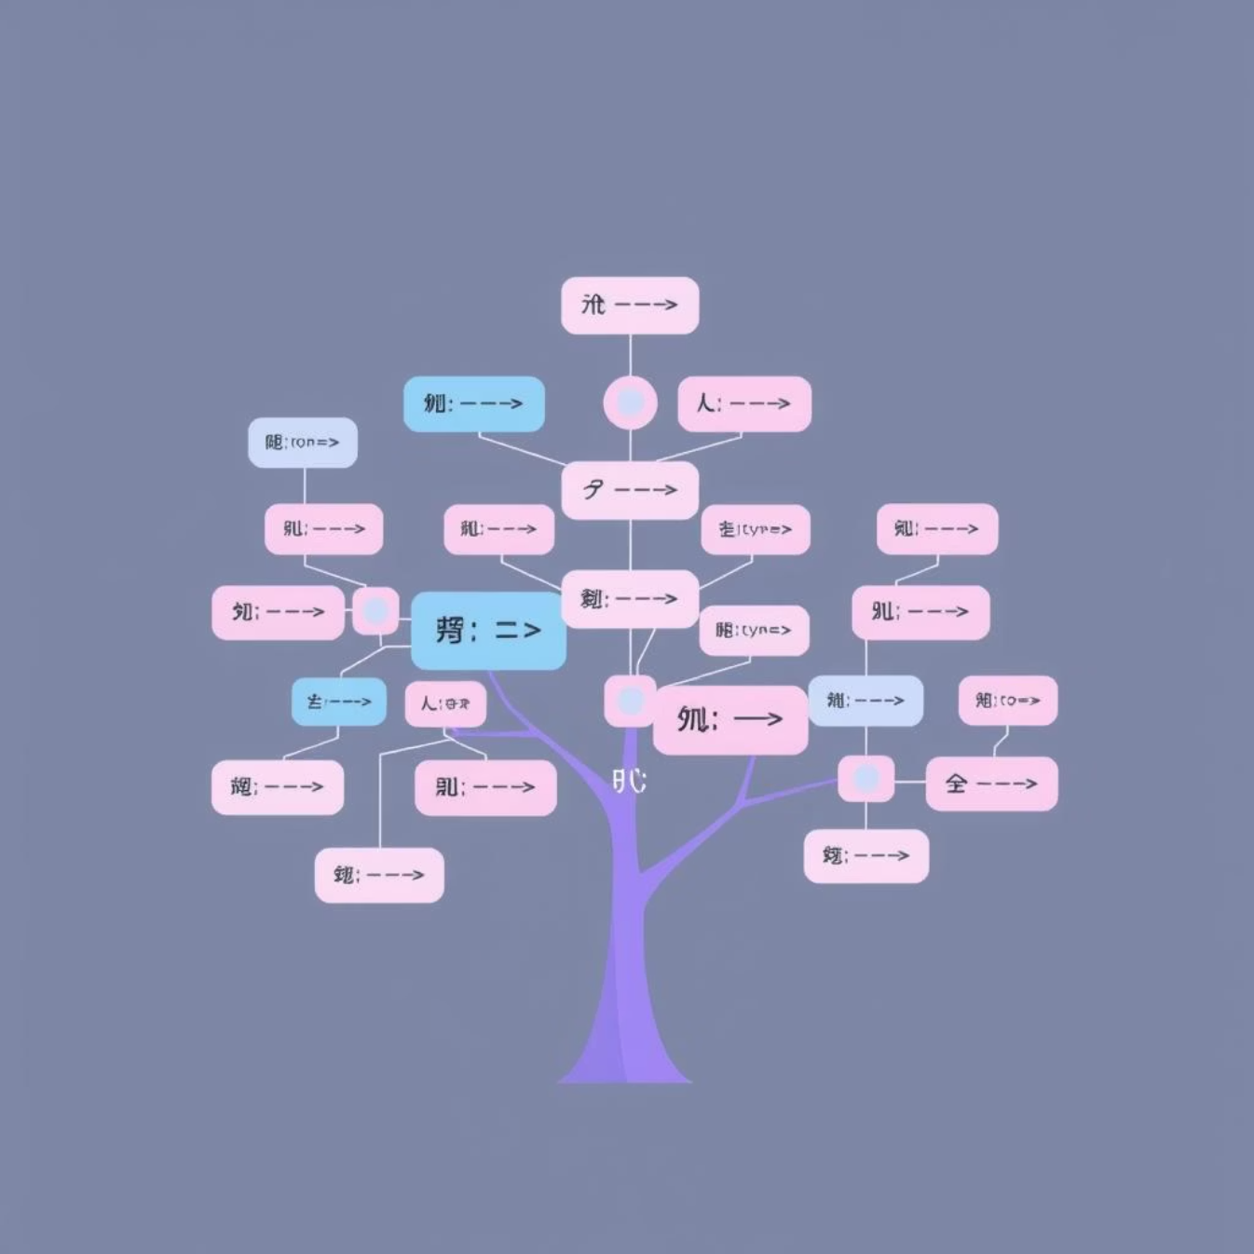
Phase 2: Syntax Analysis - Building the AST
Parser Type: Recursive Descent
Key Feature: Panic-Mode Error Recovery
MaxLang employs a Recursive Descent Parser, a top-down parsing technique that aligns well with our LL(1) grammar. Each grammar rule is typically implemented as a dedicated function.
To enhance user experience, our parser implements panic-mode error recovery. Instead of halting at the first syntax error, it attempts to resynchronize and continue parsing, reporting multiple errors in a single pass.
Structure: Abstract Syntax Tree
The parser's output is a well-formed Abstract Syntax Tree (AST). This hierarchical representation captures the syntactic structure of the program, forming the basis for subsequent compiler phases.

Slide 7




Phase 3: Semantic Analysis - Ensuring Meaning & Correctness
Type Checking
The semantic analyzer rigorously performs type checking, ensuring that all operations are applied to compatible integer types and preventing common programming errors.
Symbol Table
A central Symbol Table, implemented using hash maps, stores information about all declared identifiers. This table is crucial for resolving names and checking scope.
Scope Management
Scope management ensures that variables are accessed within their defined visibility rules, preventing unauthorized access and maintaining program integrity.
This phase validates the program's logical consistency and adherence to MaxLang's rules, bridging the gap between syntax and executable meaning.

Slide 8
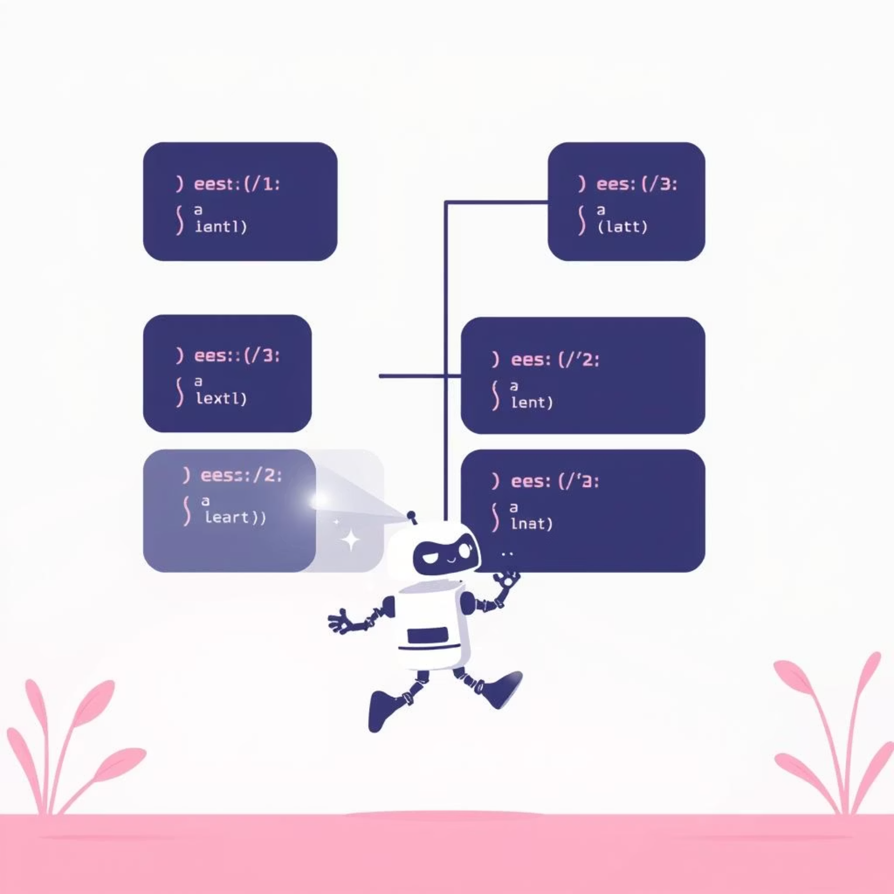

Phase 4: Interpretation - Executing the MaxLang Program
Method: Tree-Walking Interpreter
Function: Direct Evaluation & Runtime Errors
MaxLang utilizes a tree-walking interpreter. This method directly traverses the Abstract Syntax Tree (AST), executing operations and statements as it encounters them, without generating intermediate bytecode or machine code.
The interpreter directly evaluates expressions and statements on the fly. It also incorporates runtime error handling, catching issues like division by zero or undefined variable access, and providing informative error messages.

Slide 9

Implementation Challenges & Solutions
Memory Management
Operator Precedence
Challenge: Preventing memory leaks and managing the lifecycle of dynamically allocated AST nodes.
Challenge: Correctly parsing expressions with multiple operators and varying precedence levels (e.g., multiplication before addition).
Solution: Employed std::unique_ptr (Smart Pointers) for automatic memory deallocation, adhering to RAII principles.
Solution: Implemented hierarchical parsing functions, where lower-precedence operators invoke higher-precedence parsing functions.

Slide 10




Future Work: Expanding MaxLang Capabilities
Language Extension: Basic Math
Control Flow: If-Else & Loops
Optimization: LLVM IR Generation
Introduce a min() function and comprehensive comparison operators (e.g., <, >, ==, !=) to enhance MaxLang's expressive power.
Integrate fundamental control flow structures: If-Else statements for conditional execution and Loop constructs (e.g., While, For) for iterative processes.
Implement LLVM IR (Intermediate Representation) Code Generation. This would allow MaxLang programs to be optimized by LLVM's powerful backend and potentially compiled to native machine code, significantly improving performance.

